Slide 1


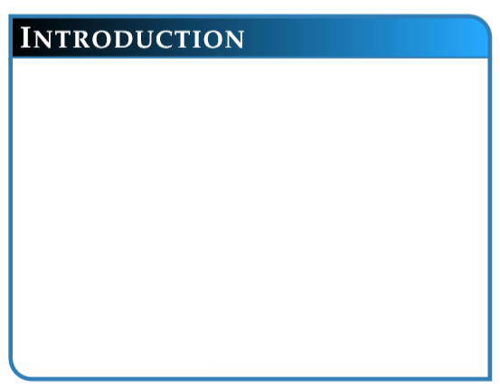
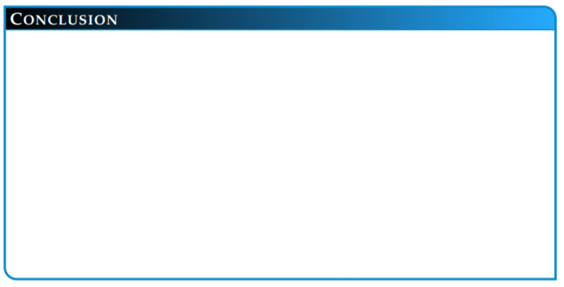
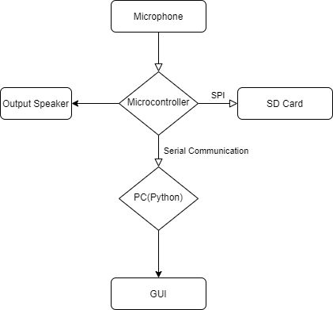

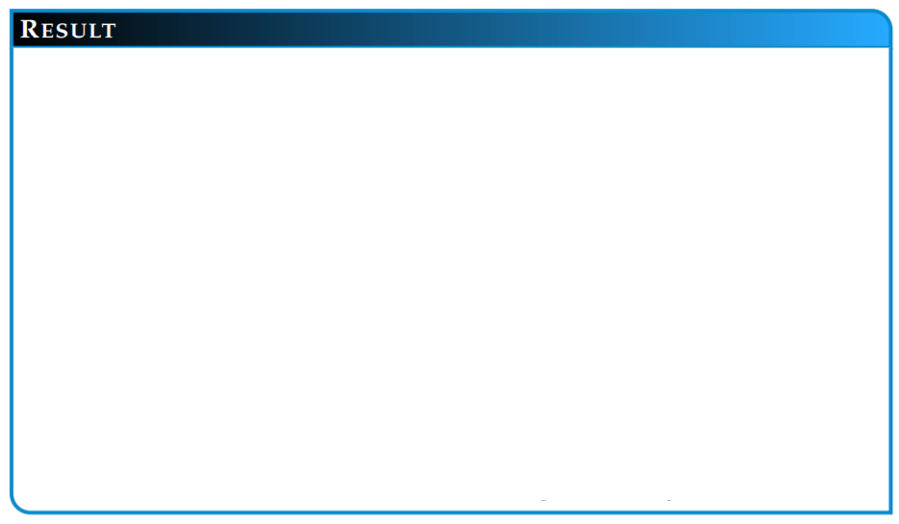
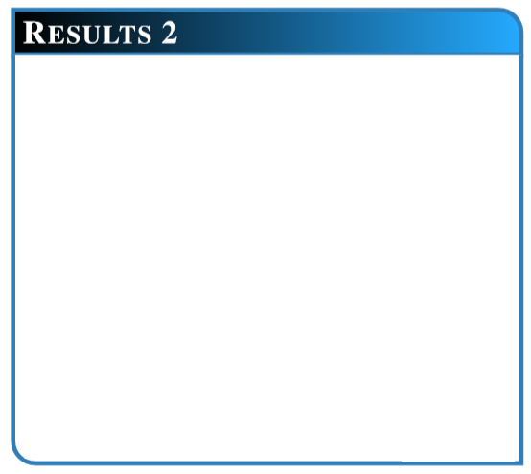
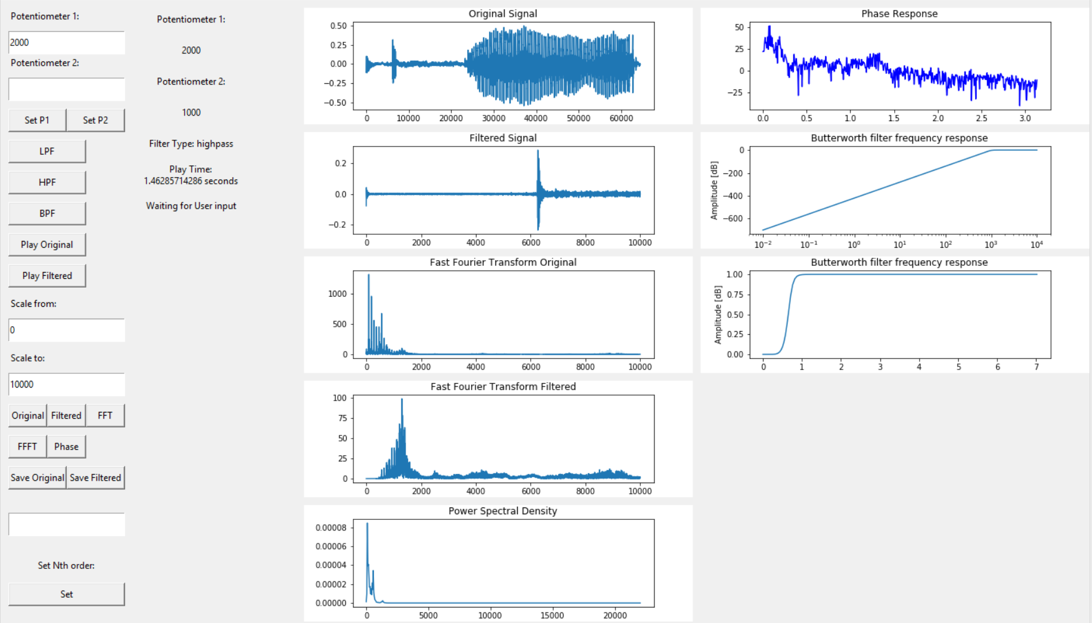
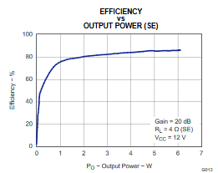
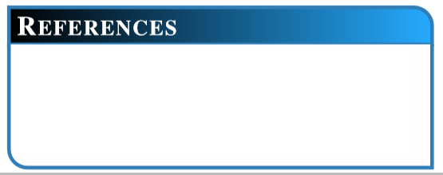
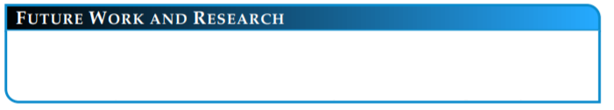
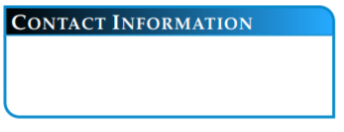
DIGITALLY CONTROLLED ANALOG FILTER W/ FFT ANALYSER (D.C.A.F.F.)
{RAMIRO CARRILLO, HENRY CHEN, MICHAEL TANG, JEFFREY LEE} UNIVERSITY OF CALIFORNIA, RIVERSIDE
The goal of DCAFF is to build a recording device that can be used by a normal user or by a professional user. DCAFF is a product that allows users to record audio and manipulate it using various filters (lowpass, highpass, and bandpass) . DCAFF also shows graphs to compare filtered signals and display it on an user interface.
DCAFF also includes local playback or playback through an audio amplifier and speaker.
DCAFF is an audio device designed for frequency filtering. This device utilises a Fast Fourier Transform (FFT) Analyzer Python program to modify and display the FFT of the filtered and original signal. This user-friendly FFT Analyzer allows the user to change between three audio filters (low-pass, high-pass, bandpass) to reduce ‘noise’ and isolate our desired audio signal. DCAFF also includes an additional Class-D Amplifier module that amplifies and outputs an audio signal via an in-built speaker.
DCAFF is able to process raw audio data that is recorded onto a microphone. The audio data is able to be formatted into traditional audio formats. With Python, multiple different filters can be used. Filters can also be customized based on user specifications.
Figure 3: Flow Chart Diagram
The following materials were used:
-Teensy 3.2
-Arduino Audio Shield
-SD card
-PC with Python
-TLC 3200 Stereo Class-D Amplifier
-4 Ohm, 3 Watt Speaker
-HP Triple Output DC Power Supply
Protocols used:
-Serial Communication (USART)
-SPI
-I2S
FFT analyzer is able to display accurate data of the audio signal. The user is able to select between filters. The user is able to adjust the cutoff frequency and the order of the filters.
Class D Amplifier is able to keep above a 90 percent and higher efficiency with little power loss as shown in Figure 2. This amplifier also has low harmonic distortion, indicating that the audio output would be recognizable. Finally, this amplifier has a small phase shift, implying that this amplifier has little delay.
Figure 1: FFT Analyzer Interface
Figure 2: Power Efficiency for Amplifier
[1] Gaalaass, Eric. “Class D Audio Amplifiers: What, Why, and How.”
Class D Audio Amplifiers: What, Why, and How | Analog Devices,
Analog Dialogue, June 2006,
www.analog.com/en/analog-dialogue/articles/class-d-audio-
-amplifiers.html#.
Henry Chen (hchen217@ucr.edu)
Ramiro Carrillo (rcarr026@ucr.edu)
Michael Tang (mtang014@ucr.edu)
Jeffrey Lee (jlee395@ucr.edu)
For future work, we would like to decrease
time to process the audio. (Using wifi or
Bluetooth to increase baud rate).
Normalizing the audio file to improve amplifier output. Improve amplifier capabilities and add volume adjustment.

